Slide 1
BIG Data Analytics: An Overview
Navneet Goyal
Department of Computer Science
BITS, Pilani (Pilani Campus)

Slide 2
Topics
Big Data Analytics
Extended RDBMS Architecture
MapReduce/Hadoop

Slide 3
BIG Data Analytics
It is like a mountain of data that you have to climb.
The height of the mountain keeps increasing everyday and you have to climb it in less time than yesterday!!
This is the kind of challenge big data throws at us
Has forced us to go back to the drawing board and design every aspect of a compute system afresh
Has spawned research in every sub area of Computer Science

Slide 4
What Is Big Data?
There is no consensus as to how to define big data
“Big data exceeds the reach of commonly used hardware environments and software tools to capture, manage, and process it with in a tolerable elapsed time for its user population.” - Teradata Magazine article, 2011
“Big data refers to data sets whose size is beyond the ability of typical database software tools to capture, store, manage and analyze.” - The McKinsey Global Institute, 2011

Slide 5
BIG DATA
BIG DATA poses a big challenge to our capabilities
Data scaling outdoing scaling of compute resources
CPU speed not increasing either
At the same time, BIG DATA offers a BIGGER opportunity
Opportunity to
Understand nature
Understand evolution
Understand human behavior/psychology/physiology
Understand stock markets
Understand road and network traffic
…
Opportunity for us to be more and more innovative!!

Slide 6
Big Data - Sources
Telecom data (≈ 4.75 bn mobile subscribers)
There are 3 Billion Telephone Calls in US each day, 30 Billion emails daily, 1 Billion SMS, IMs.
IP Network Traffic: up to 1 Billion packets per hour per router. Each ISP has many (hundreds) routers!
WWW
Weblog data (160 mn websites)
Email data
Satellite imaging data
Social networking sites data
Genome data
CERN’s LHC (15 petabytes/year)
Notes:
Data produced by LHC as well as LHC-related simulation will produce a total data output of 15 petabytes per year.^{[43]} For comparison, every word spoken worldwide in one year, converted into text, would amount to 2–3 petabytes of data.
[43] CERN LHC Computing". CERN. 2008. http://public.web.cern.ch/public/en/LHC/Computing-en.html. Retrieved 2009-09-28.

Slide 7
BIG DATA
Just a Hype?
Or a real Challenge?
Or a great Opportunity?
Challenge in terms of how to manage & use this data
Opportunity in terms of what we can do with this data to enrich the lives of everybody around us and to make our mother Earth a better place to live
We are living in a world of DATA!!
We are (partly) and will be (fully) driven by DATA

Slide 8
BIG DATA
We are generating more Data that we can handle!!!
Using Data to our benefit is a far cry!!!
In future, everything will be Data driven
High time we figured out how to tame this “monster” and use it for the benefit of the society

Slide 9
BIG DATA
Best Quote so far…
Dhiraj Rajaram, Founder & CEO of Mu Sigma, leading Data Analytics co.
"Data is the new 'oil' and there is a growing need for the ability to refine it,"

Slide 10
BIG DATA
Another Interesting Quote
“We don’t have better Algorithms, We just have more data”
- Peter Norvig, Director of Research, Google

Slide 11
Analyzing BIG DATA
Data analysis, organization, retrieval, and modeling are other foundational challenges. Data analysis is a clear bottleneck in many applications, both due to lack of scalability of the underlying algorithms and due to the complexity of the data that needs to be analyzed*
*Challenges and Opportunities with Big Data
A community white paper developed by leading researchers across the United States

Slide 12
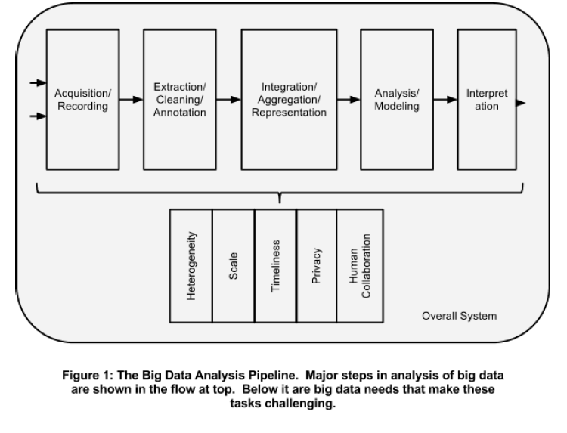
Source:Challenges and Opportunities with Big Data
A community white paper developed by leading researchers across the United States

Slide 13
BIG DATA
BIG DATA is spawning research in:
Databases
Data Analytics (Data Warehousing, Data Mining & Machine Learning)
Parallel Programming & Programming Models
Distributed and High Performance Computing
Domain Specific Languages
Storage Technologies
Algorithms & Data Structures
Data Visualization
Architecture
Networks
Green Computing
…

Slide 14
BIG Data Analytics
Data Warehousing, Data Mining & Machine Learning are at the core of BIG Data Analytics

Slide 15
Why Cluster Computing?
Scalable
Only way forward to deal with Big Data
Embrace this technology till any new disruptive/revolutionary technology surfaces

Slide 16
Extended RDBMS Architecture*
Support for new data types required by BIG data
Vectors & matrices
Multimedia data
Unstructured and semi-structured data
Collection of name-value pairs, called as data bags
Provide support for processing new data types within the DBMS inner loop by means of user-defined functions
* The DW Toolkit, Kimball & Ross (Chapter 21), Wiley, 3e

Slide 17
MapReduce*
What’s there in a name?
Everything!!
Map + Reduce
Both are functions used in “functional programming”
Has primitives in LISP & other functional PLs
So what is functional programming?
* Google paper 2004: MapReduce: Simplified Data Processing on Large Clusters
Jeffrey Dean and Sanjay Ghemawat
OSDI, 2004

Slide 18
Functional Programming
Functional programming is a programming paradigm that treats computation as the evaluation of mathematical functions
Interactive PL
Expression Value
(function arg1 arg2 …argn)*
(+ 12 23 34 45)
104
*Scheme – a dialect of LISP, is the 2nd oldest PL that is still in use

Slide 19
Functional Programming
In early days computer use was very expensive, it was obvious to have the programming language resemble the architecture of the computer as close as possible.
A computer consists of a central processing unit and a memory.
Therefore a program consisted of instructions to modify the memory, executed by the processing unit
With that the imperative programming style arose
Imperative programming language, like Pascal and C, are characterized by the existence of assignments, executed sequentially.
Reference: Functional Programming by Jeroen Fokker

Slide 20
Functional Programming
Functions express the connection between parameters (the ‘input’) and the result (the ‘output’) of certain processes.
In each computation the result depends in a certain way on the parameters. Therefore a function is a good way of specifying a computation.
This is the basis of the functional programming style.
A ‘program’ consists of the definition of one or more functions
With the ‘execution’ of a program the function is provided with parameters, and the result must be calculated.
With this calculation there is still a certain degree of freedom
For instance, why would the programmer need to prescribe in what order independent subcalculations must be executed?
Reference: Functional Programming by Jeroen Fokker

Slide 21
Functional Programming
The theoretical basis of imperative programming was already founded in the 30s by Alan Turing (in England) and John von Neuman (in the USA)
The theory of functions as a model for calculation comes also from the 20s and 30s. Some of the founders are M. Sch¨onfinkel (in Germany and Russia), Haskell Curry (in England) and Alonzo Church (in the USA
The language Lisp of John McCarthy was the first functional programming language, and for years it remained the only one
Reference: Functional Programming by Jeroen Fokker

Slide 22
Functional Programming
ML, Scheme (an adjustment to Lisp), Miranda and Clean are other examples of functional programming languages
Haskell (first unified PL) & Gofer (a simplified version of Haskell)
ML & Schemes have overtones of imperative programming languages and therefore are not purely FPLs
Miranda is a purely FPL!
Reference: Functional Programming by Jeroen Fokker

Slide 23
Gofer
? 5+2*3
11
(5 reductions, 9 cells)
?
The interpreter calculates the value of the expression entered, where * denotes multiplication.
After reporting the result (11) the interpreter reports the calculation took ‘5 reductions’ (a measure for the amount of time needed) and ‘9 cells’ (a measure for the amount of memory used)
The question mark shows the interpreter is ready for the next expression
Reference: Functional Programming by Jeroen Fokker

Slide 24
Gofer
? sum [1..10]
55
(91 reductions, 130 cells)
In this example [1..10] is the Gofer notation for the list of numbers from 1 to 10.
The standard function sum can be applied to such a list to calculate the sum (55) of those numbers.
A list is one of the ways to compose data, making it possible to apply functions to large amounts of data.
Lists can also be the result of a function:
? sums [1..10]
[0, 1, 3, 6, 10, 15, 21, 28, 36, 45, 55]
(111 reductions, 253 cells)
The standard function sums returns next to the sum of the numbers in the list also all the intermediate results.
Reference: Functional Programming by Jeroen Fokker

Slide 25
Gofer
? reverse (sort [1,6,2,9,2,7])
[9, 7, 6, 2, 2, 1]
(52 reductions, 135 cells)
g (f x) means that f should be applied to x and g should be applied to the result of that
Gofer is a largely parenthesis free language
Reference: Functional Programming by Jeroen Fokker

Slide 26
Gofer: Defining New Functions
The editor is called by typing ‘:edit’, followed by the name of a file, for example:
? :edit new
Definition of the factorial function can be put in the file ‘new’.
In Gofer the definition of the function fac could look like:
fac n = product [1..n]
Reference: Functional Programming by Jeroen Fokker

Slide 27
Gofer: Defining New Functions
? :load new
Reading script file "new":
Parsing..........................................................
Dependency analysis..............................................
Type checking....................................................
Compiling........................................................
Gofer session for:
/usr/staff/lib/gofer/prelude
new
?
Now fac can be used
? fac 6
720
(59 reductions, 87 cells)
Reference: Functional Programming by Jeroen Fokker

Slide 28
Gofer: Adding fn to a file
It is possible to add definitions to a file when it is already loaded. Then it is sufficient to just type :edit; the name of the file needs not to be specified.
For example a function which can be added to a file is the function ‘n choose k’: the number of ways in which k objects can be chosen from a collection of n objects
This definition can, just as with fac, be almost literally been written down in Gofer:
choose n k = fac n / (fac k * fac (n-k))
Example:
? choose 10 3
120
(189 reductions, 272 cells)
Reference: Functional Programming by Jeroen Fokker

Slide 29
Gofer: Defining a New Operator
A operator is a function with two parameters which is written between the parameters instead o fin front of them
In Gofer it is possible to define your own operators
The function choose from could have been defined as an operator, for example as !ˆ! :
n !^! k = fac n / (fac k * fac (n-k))
Reference: Functional Programming by Jeroen Fokker

Slide 30
Gofer: Nesting Functions
Parameter of a function can be a function itself too!
An example of that is the function map, which takes two parameters: a function and a list.
The function map applies the parameter function to all the elements of the list.
For example:
? map fac [1,2,3,4,5]
[1, 2, 6, 24, 120]
? map sqrt [1.0,2.0,3.0,4.0]
[1.0, 1.41421, 1.73205, 2.0]
? map even [1..8]
[False, True, False, True, False, True, False, True]
Functions with functions as a parameter are frequently used in Gofer (why did you think it was called a functional language?).
Reference: Functional Programming by Jeroen Fokker

Slide 31
MapReduce/Hadoop
MapReduce* - A programming model & its associated implementation
provides a high level of abstraction
but has limitations
Only data parallel tasks stand to benefit!
MapReduce hides parallel/distributed computing concepts from users/programmers
Even novice users/programmers can leverage cluster computing for data-intensive problems
Cluster, Grid, & MapReduce are intended platforms for general purpose computing
Hadoop/PIG combo is very effective!
*MapReduce: Simplified Data Processing on Large Clusters
Jeffrey Dean and Sanjay Ghemawat, OSDI, 2004

Slide 32
MapReduce
MapReduce works by breaking processing into the following 2 phases:
Map (inherently parallel – each list el. processed ind.)
Reduce (inherently sequential)

Slide 33
Map Function
Applies to a list
map(function, list) calls function(item) for each of the list’s items and returns a list of the return values. For example, to compute some cubes:
>>> def cube(x): return x*x*x
...
>>> map(cube, range(1, 11))
[1, 8, 27, 64, 125, 216, 343, 512, 729, 1000, 1331]

Slide 34
Reduce Function
Applies to a list
reduce(function, list) returns a single value constructed by calling the binary function on the first two items of the list, then on the result and the next item, and so on…
For example, to compute the sum of the numbers 1 through 11:
>>> def add(x,y): return x+y
...
>>> reduce(add, range(1, 11))
66

Slide 35
My view of MapReduce
Distribute
Data
Distributed file system
Compute
MAP
Parallelism
Compile
REDUCE
Aggregate

Slide 36
MapReduce
A programming model & its associated implementation
MapReduce is a patented software framework introduced by Google to support distributed computing on large data sets on clusters of computers (wiki defn.)
Inspired by the map & reduce functions of functional programming (in a tweaked form)

Slide 37
MapReduce
MapReduce is a framework for processing huge datasets on certain kinds of distributable problems using a large number of computers
cluster (if all nodes use the same hardware) or as
grid (if the nodes use different hardware)
(wiki defn.)
Computational processing can occur on data stored either in a filesystem (unstructured) or within a database (structured).

Slide 38
MapReduce
Programmer need not worry about:
Communication between nodes
Division & scheduling of work
Fault tolerance
Monitoring & reporting
Map Reduce handles and hides all these dirty details
Provides a clean abstraction for programmer

Slide 39
Composable Systems
Processing can be split into smaller computations and the partial results merged after some post-processing to give the final result
MapReduce can be applied to this class of scientific applications that exhibit composable property.
We only need to worry about mapping a particular algorithm to Map & Reduce
If you can do that, with a little bit of high level programming, you are through!
SPMD algorithms
Data Parallel Problems

Slide 40
SPMD Algorithms
It’s a technique to achieve parallelism.
Tasks are split up and run on multiple processors simultaneously with different input data
The robustness provided by MapReduce implementations is an important feature for selecting this technology for such SPMD algorithms.

Slide 41
Hadoop
MapReduce isn’t available outside Google!
Hadoop/HDFS is an open source implementation of MapReduce/GFS
Hadoop is a top-level Apache project being built and used by a global community of contributors, using Java
Yahoo! has been the largest contributor to the project, and uses Hadoop extensively across its businesses

Slide 42
Hadoop & Facebook
FB uses Hadoop to store copies of internal log and dimension data sources and use it as a source for reporting/analytics and machine learning.
Currently FB has 2 major clusters:
A 1100-machine cluster with 8800 cores and about 12 PB raw storage.
A 300-machine cluster with 2400 cores and about 3 PB raw storage.
Each (commodity) node has 8 cores and 12 TB of storage.
FB has built a higher level data warehousing framework using these features called Hive http://hadoop.apache.org/hive/
Have also developed a FUSE implementation over hdfs.
First company to abandon RDBMS and adopt Hadoop for implementation of a DW

Slide 43
A word about HIVE
A data warehouse infrastructure built on top of Hadoop
Enables easy data summarization, adhoc querying and analysis of large datasets data stored in Hadoop files.
provides a mechanism to put structure on this data
A simple query language called Hive QL (based on SQL) which enables users familiar with SQL to query this data.
HIVE QL allows traditional map/reduce programmers to be able to plug in their custom mappers and reducers to do more sophisticated analysis which may not be supported by the built-in capabilities of the language.

Slide 44
Hadoop & Yahoo
YAHOO
More than 100,000 CPUs in >36,000 computers running Hadoop
Biggest cluster: 4000 nodes (2*4cpu boxes w 4*1TB disk & 16GB RAM)
Used to support research for Ad Systems and Web Search
Also used to do scaling tests to support development of Hadoop on larger clusters

Slide 45
HDFS
Data is organized into files & directories
Files are divided into uniform sized blocks (64 MB default) & distributed across cluster nodes
Blocks are replicated ( 3 default)to handle HW failure
Replication for performance & fault tolerance
Checksum for data corruption detection & recovery

Slide 46
Word Count using Map Reduce
Mapper
Input: <key: offset, value:line of a document>
Output: for each word w in input line output<key: w, value:1>
Input: (The quick brown fox jumps over the lazy dog.)
Output: (the, 1) , (quick, 1), (brown, 1) … (fox,1), (the, 1)
Reducer
Input: <key: word, value: list<integer>>
Output: sum all values from input for the given key input list of values and output <Key:word value:count>
Input: (the, [1, 1, 1, 1,1]), (fox, [1, 1, 1]) …
Output: (the, 5)
(fox, 3)

Slide 47
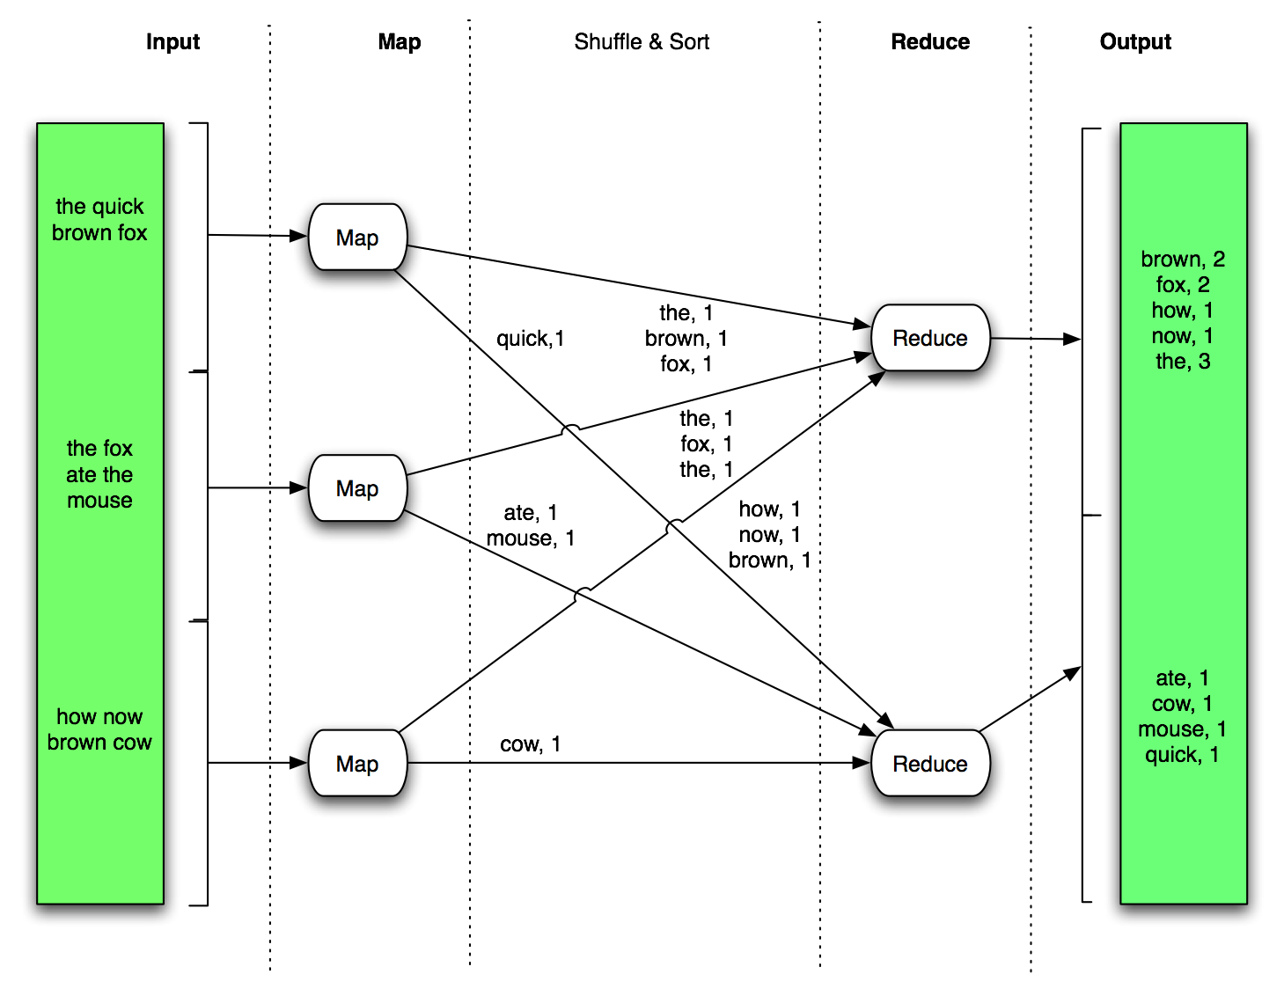
Word count
Input
Map
Shuffle
Reduce
Output
http://www.slideshare.net/hadoop/practical-problem-solving-with-apache-hadoop-pig
By Milind Bhandarkar

Slide 48
Map Reduce Architecture
Map Phase
Map tasks run in parallel – output intermediate key value pairs
Shuffle and sort phase
Map task output is partitioned by hashing the output key
Number of partitions is equal to number of reducers
Partitioning ensures all key/value pairs sharing same key belong to same partition
The map output partition is sorted by key to group all values for the same key
Reduce Phase
Each partition is assigned to one reducer.
Reducers also run in parallel.
No two reducers process the same intermediate key
Reducer gets all values for a given key at the same time

Slide 49
Applications in Data Warehousing
Aggregate queries
Product-wise sales for the year 2010

Slide 50
Strengths of MapReduce
Provides highest level of abstraction!
(as on date)
Learning curve – manageable
Highly scalable
Highly fault tolerant
Economical!!

Slide 51
Q & A

